Slide 1
Smart Insights into the Bengaluru Housing Market
Subtitle: Exploratory Data Analysis for Real Estate Intelligence
Team Members
Saniya
Dhvani
Yuva

Slide 2
Problem Statement
• Property price variation across locations is unclear
• Buyers lack data-driven decision support
• Understanding market trends is difficult

Slide 3
Our Solution Approach
Raw Housing Data
↓
Data Cleaning
↓
EDA & Visualization
↓
Market Insights
↓
Decision Support

Slide 4
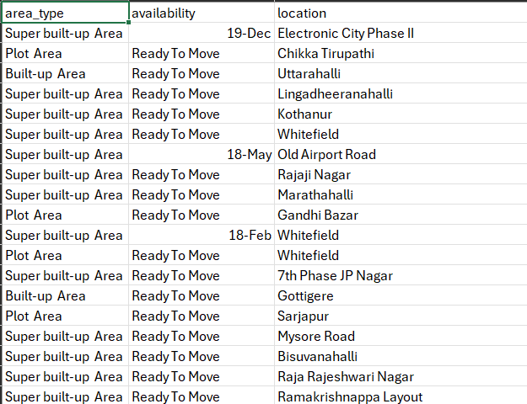
Dataset Overview
• Real-world housing market dataset
(Bengaluru Housing Dataset)
• 13K+ property listings
• Features: Location, Size, Area, Bathrooms, Price

Slide 5
Data Preparation
✔ Removed irrelevant data
✔ Filled missing values intelligently
✔ Preserved maximum information
✔ Created BHK feature
After preparing the data, we analyzed market patterns using visualization.

Slide 6
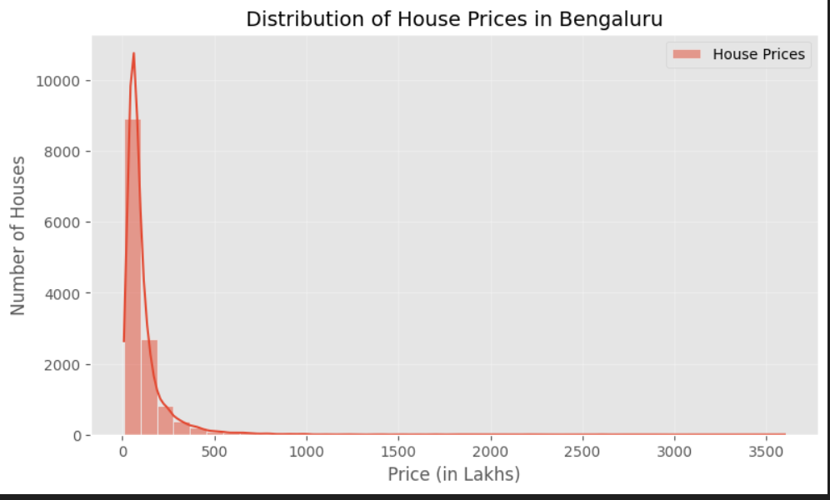
Most Houses Fall in the Mid-Price Range
Key Observations:
• Most properties lie between 40–150 Lakhs
• Very high-price houses are limited
• Distribution is right-skewed
• Indicates demand for mid-range housing

Slide 7
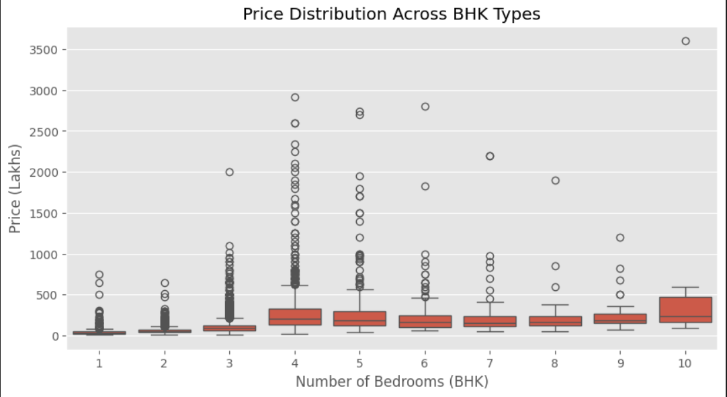
2BHK & 3BHK Homes Dominate Market Demand
Insights :
Most listings are 2–3 BHK
Higher BHK → higher price variation

Slide 8
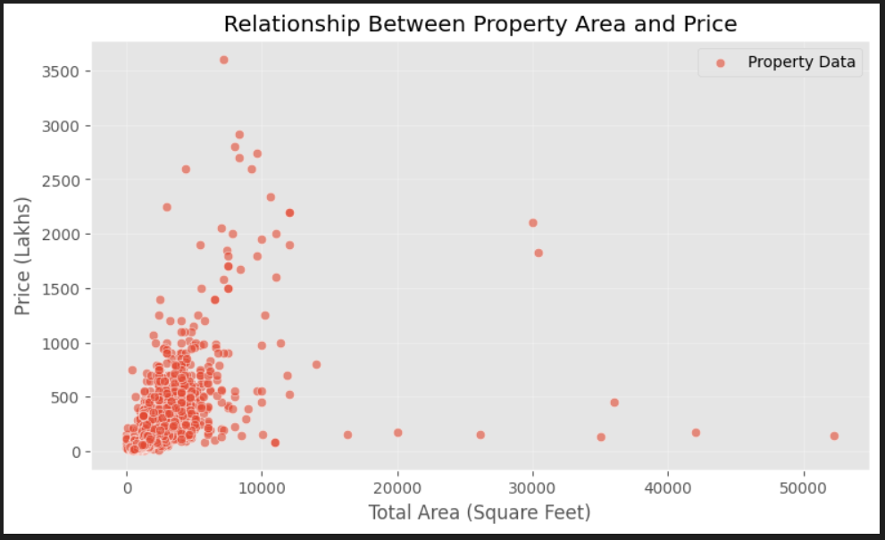
Property Size is a Major Price Driver
Insights :
Larger area → higher price
Positive relationship visible

Slide 9
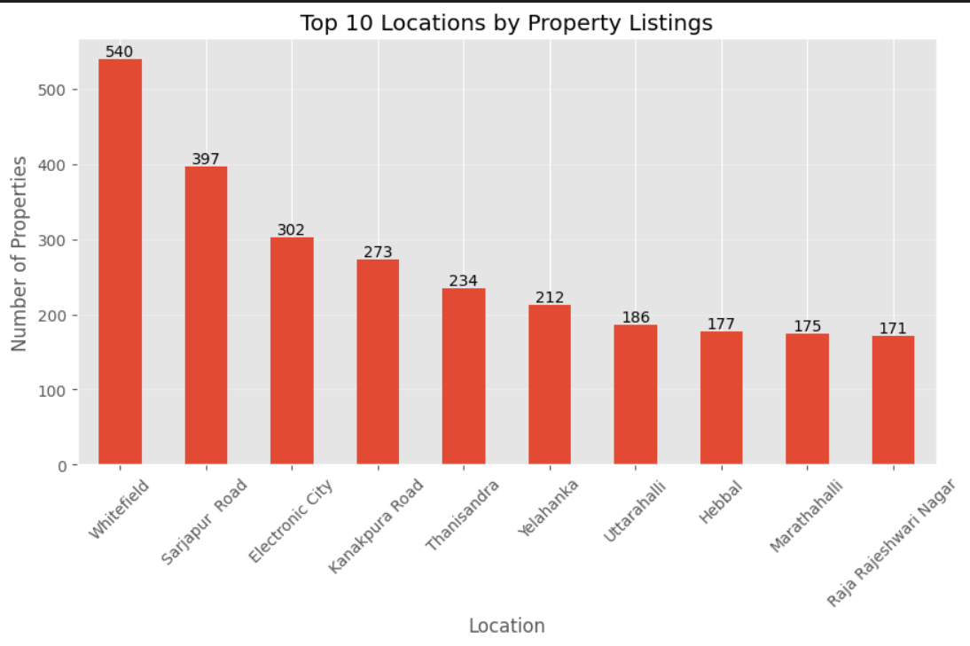
High-Demand Residential Locations
Insights :
Whitefield & Sarjapur Road dominate listings
Indicates residential hotspots

Slide 10
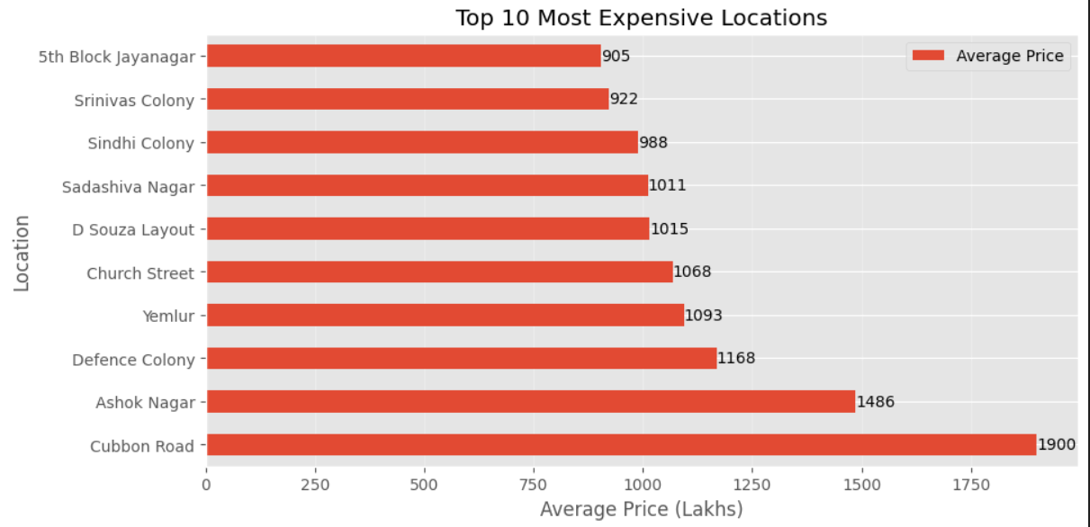
Location is the Strongest Price Factor
Insights :
• Premium areas have higher average prices
• Geography impacts valuation

Slide 11
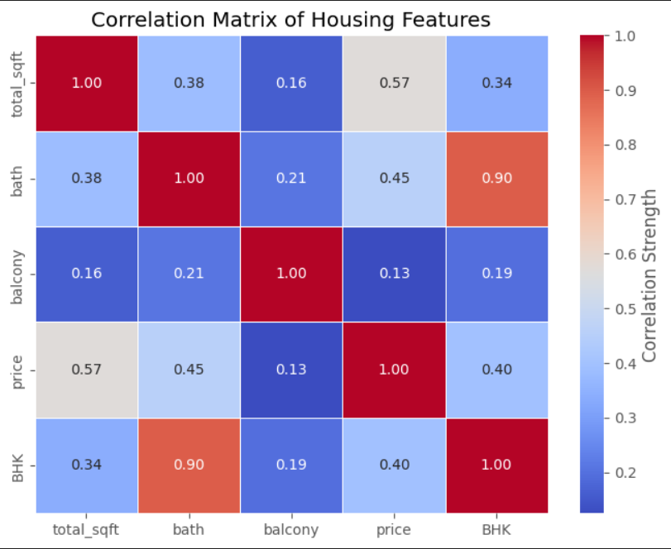
Features Driving Affecting House Prices
Insights :
• Price correlates with:
- Total Sqft
- Bathrooms
- BHK
As living space and available facilities increases property also increases because buyer always search for more functional homes with high comfort

Slide 12
Key Insights
📍 Location strongly affects price
📏 Larger homes cost more
🏠 2BHK & 3BHK dominate listings
🛁 Bathrooms influence valuation

Slide 13
Real-World Impact
✔ Helps buyers choose better locations
✔ Supports investment decisions
✔ Enables data-driven real estate analysis
✔ Foundation for price prediction systems

Slide 14
Conclusion
• Exploratory Data Analysis helped understand the
Bengaluru housing market using real-world data.
• The analysis shows that location, property size,
and BHK configuration are the main factors
influencing house prices.
• Most properties belong to the mid-price segment,
indicating strong demand for affordable housing.
• Data-driven analysis can support smarter buying,
investment, and real estate decision-making.
→ Data transforms real estate decisions into informed decisions.

Slide 15
Thank you

